Slide 1
LUCIDITY APP
This training is provided for employees downloading and using the Lucidity App for Inform and Incident

Slide 2
Introduction
The Lucidity App is available in iOS and Android and is available from the App Store and Google Play
Search for Lucidity Software and download

Slide 3
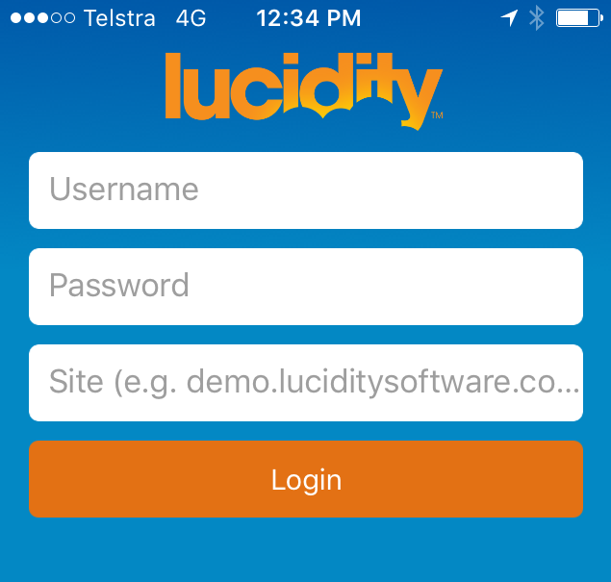
Logging into the App
Enter your Username and Password (the same details as you would use via a web browser).
In the Site field enter the url (address) of your site (e.g. demo.luciditysoftware.com.au)
Note: Don’t include the https:// when entering the url of your site.

Slide 4
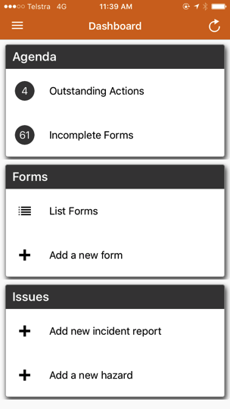
The Dashboard
Once logged in, you will be taken to your Dashboard
From the Dashboard you can:
Manage your Actions
Start new Forms or complete existing Forms
Report an Incident
Report a Hazard

Slide 5
Refresh
The Lucidity App periodically refreshes all information that is stored on the mobile device, however a refresh icon is also provided (top right). Tapping this icon will do the following:
All forms, hazards, incidents and actions are automatically synced with the database when they are saved on the mobile device.

Slide 6
Inform – Incomplete Forms
Continue Incomplete Forms

Slide 7
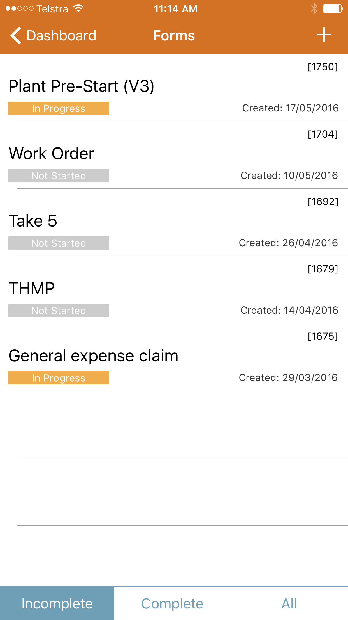
Inform – Incomplete Forms
The Incomplete Forms link provides access to the forms that the user is the Respondent for, and are not complete. Tap any form to open it.
Colour coding is used to highlight the current status of each form.

Slide 8
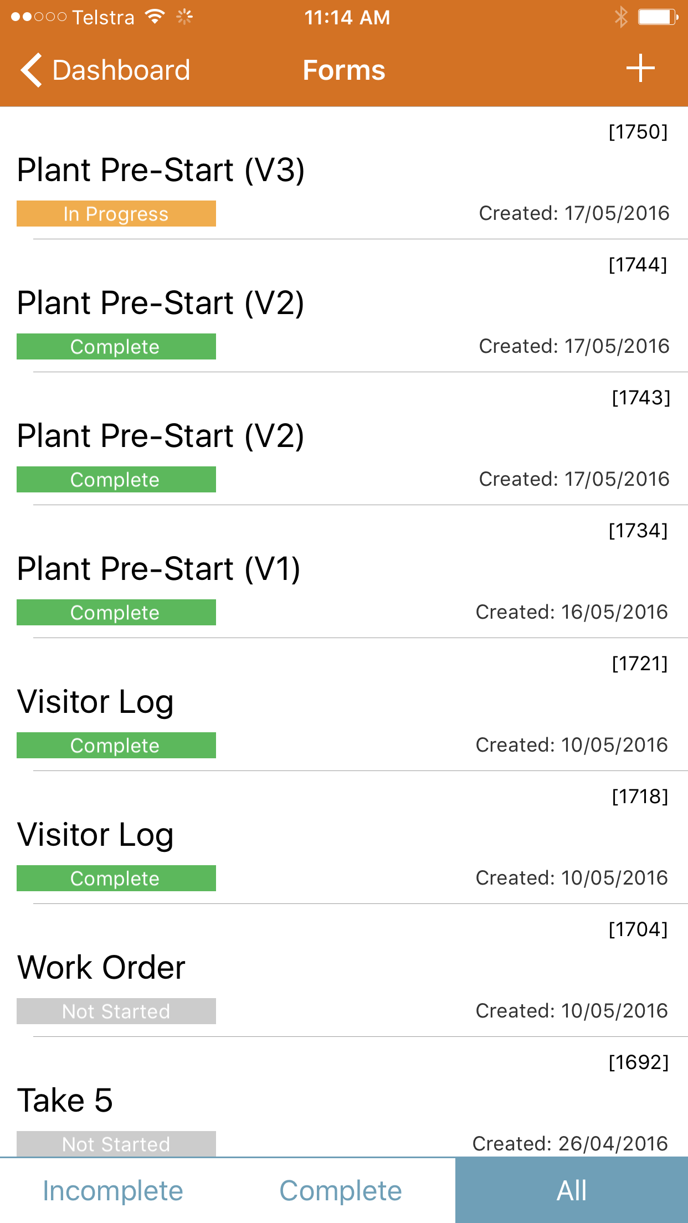
Inform – List Forms
Forms which are Complete, or All Forms can also be viewed by tapping the buttons on the bottom of the screen, or selecting the List Forms link via the Dashboard

Slide 9
Inform – Add a New Form
Add a New Form

Slide 10
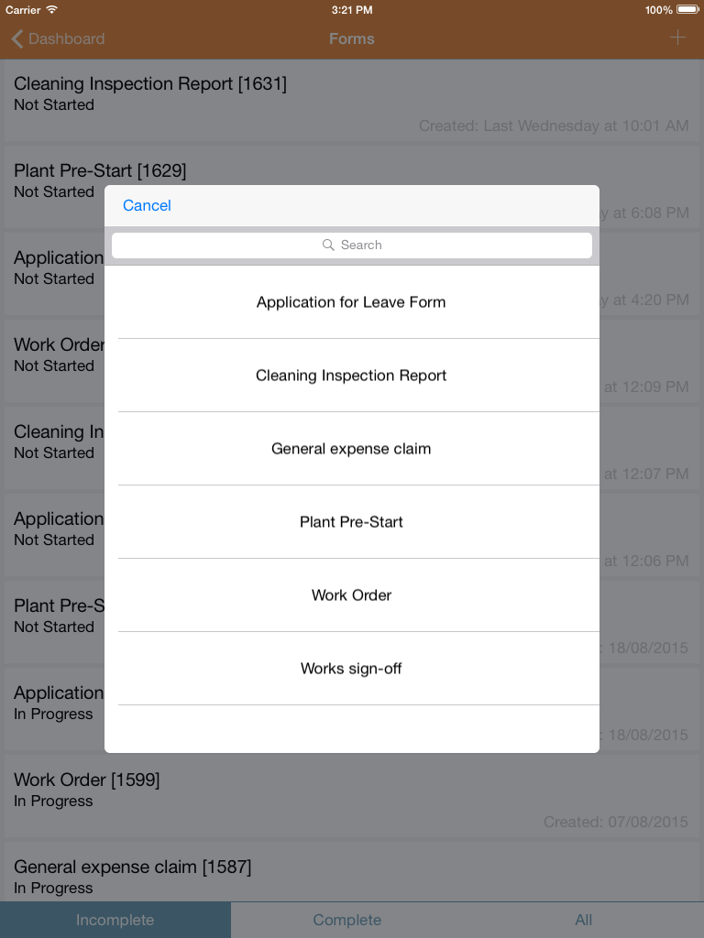
Inform – Add a New Form
To commence a new form, follow these steps:
On the Dashboard, click the 'Add a new form' link.
This will display a list of available forms. Search for forms by typing in the search bar. Select the required form by clicking its title.

Slide 11
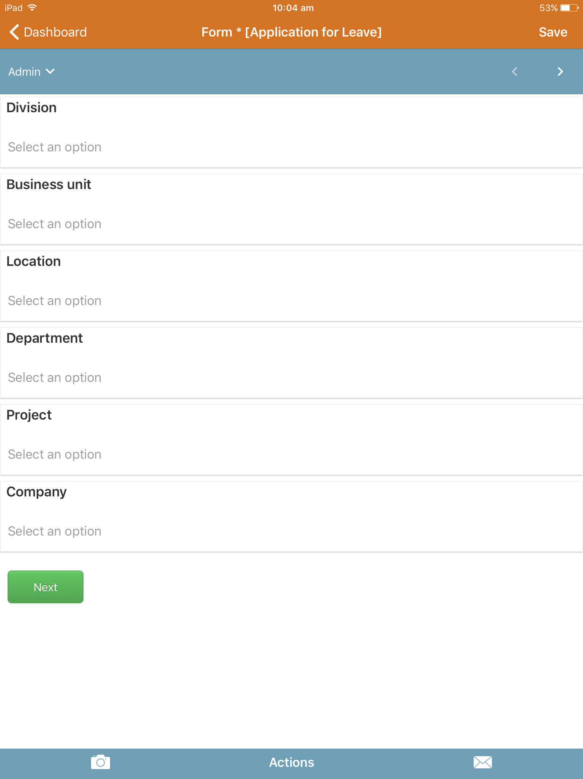
Inform – Add a New Form
The next screen will display administration details about the form which is being completed.
Enter information as appropriate and press Next or the right arrow in the navigation bar.

Slide 12
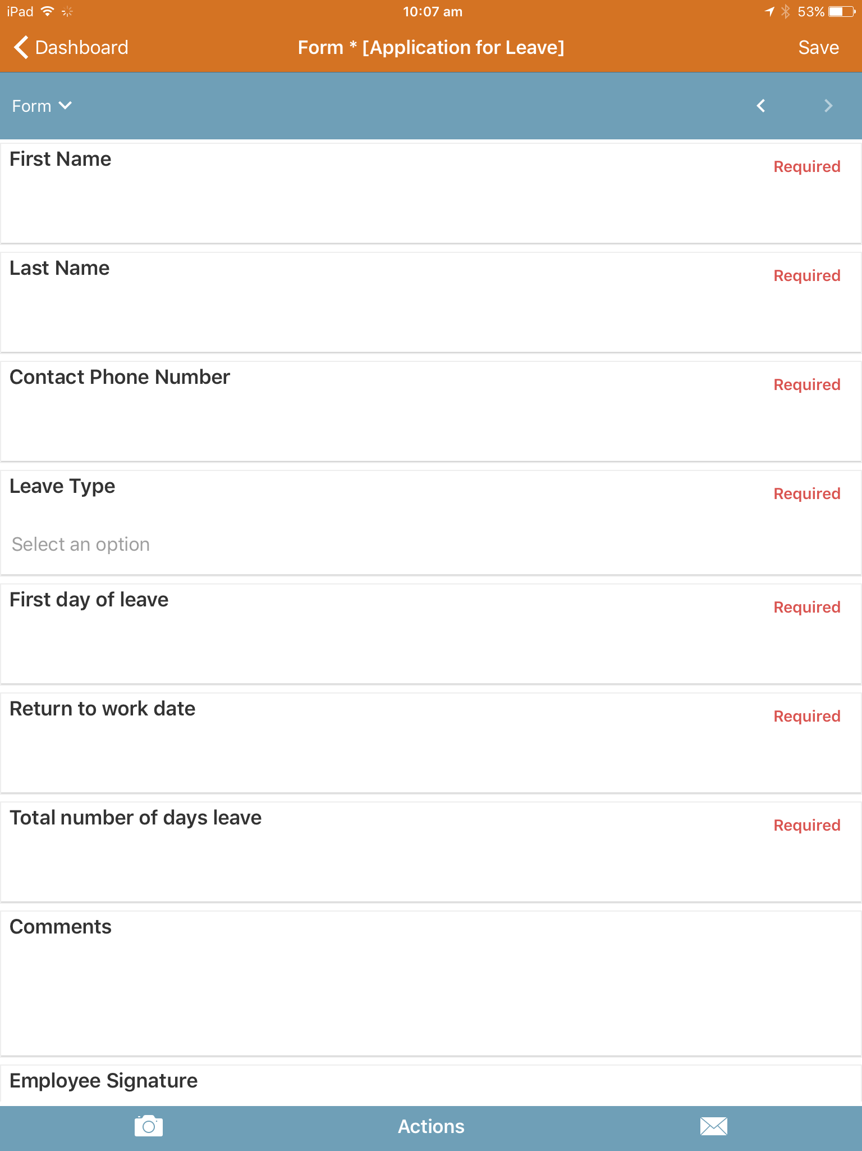
Inform – Add a New Form
Scroll through the form and complete details as required.
At any time click Save to close the form and keep existing changes
At any time click Dashboard to close the form and discard changes
Items with Required or * need to be completed for the form to be marked as Complete. These do not prevent a form from saving.

Slide 13
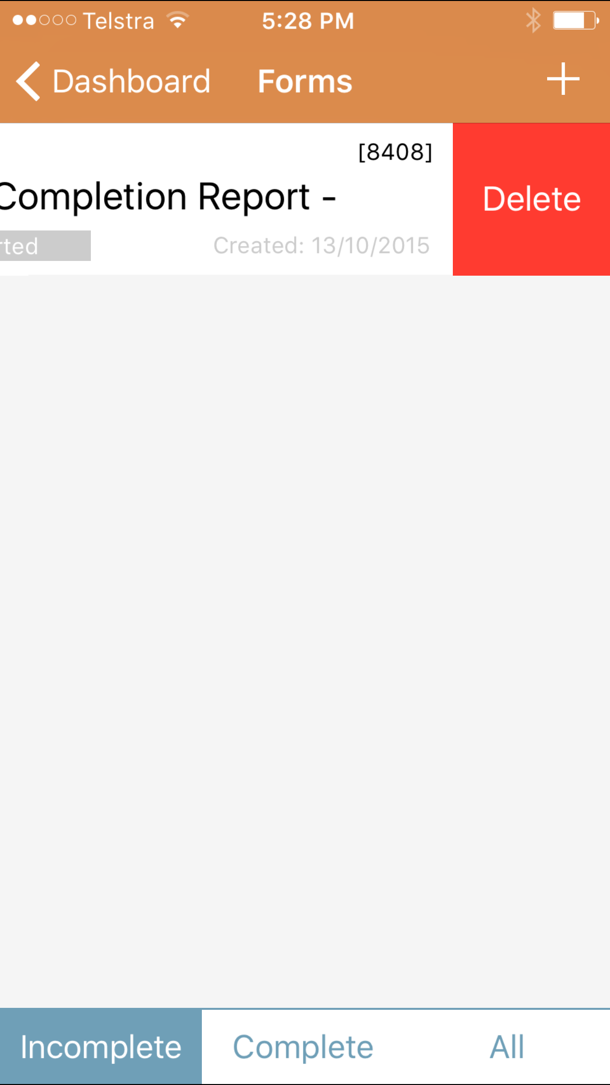
Inform – Deleting a Form
To delete a form, return to the form list page and swipe to the left. Once the Delete button is visible, tap it to complete the deletion.
Deleted form records cannot be retrieved.

Slide 14
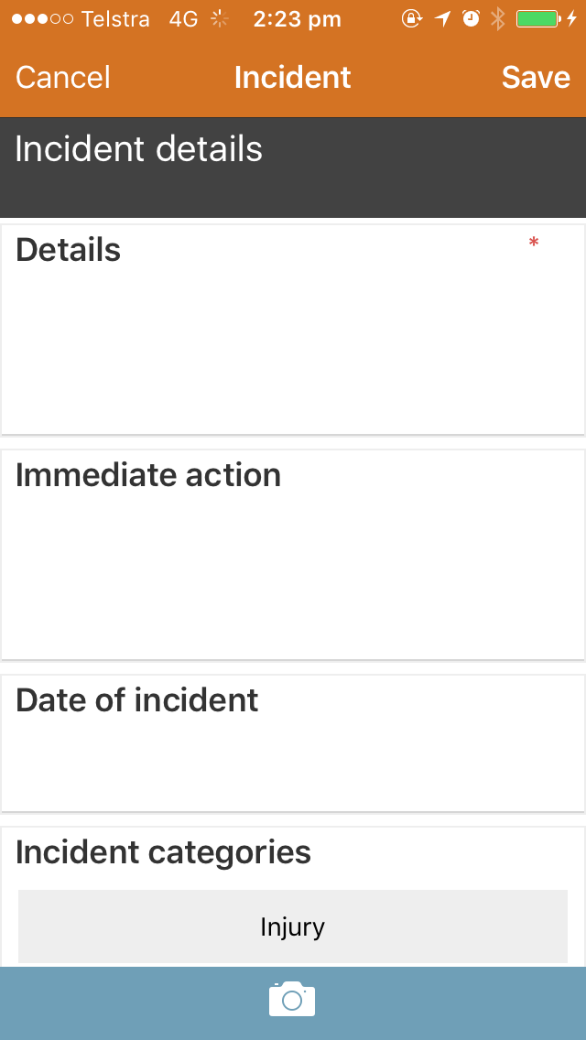
Report an Incident
Tap the Add new Incident Report link via the Dashboard.
Complete the Incident report with as much detail as you can.

Slide 15
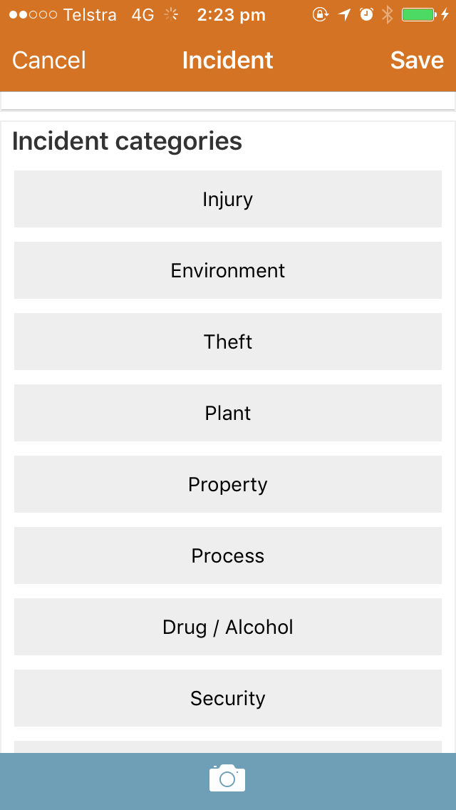
Report an Incident
Select the Incident Category from the available list.
Select the Actual Incident classification.
Select the Potential Incident classification.
Complete the Org Structure details and click Save.

Slide 16
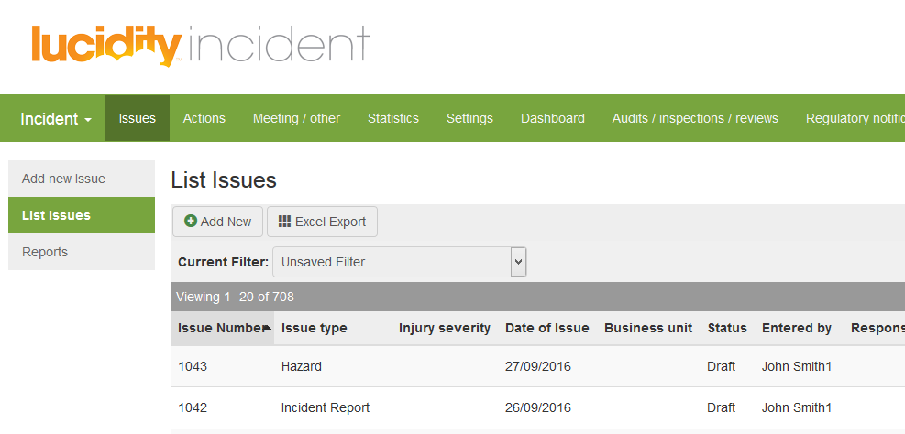
Report an Incident
The Incident Report will be saved as a Draft and is accessible via Lucidity Incident for further investigation and follow up

Slide 17
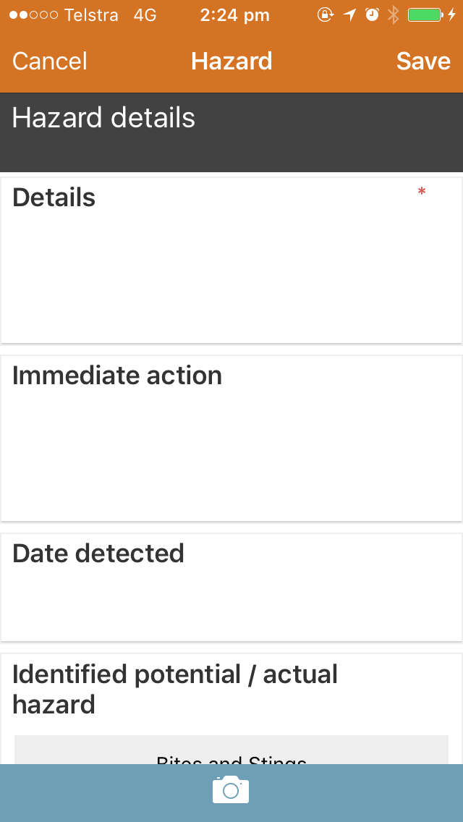
Report a Hazard
Tap the Add a new Hazard link via the Dashboard.
Complete the Hazard report with as much detail as you can.

Slide 18
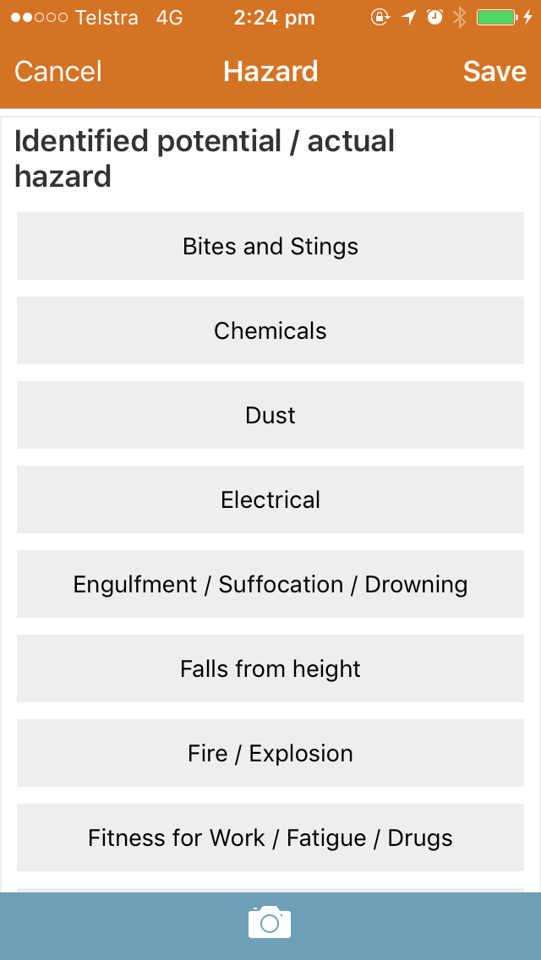
Report a Hazard
Select the potential / actual identified hazard from the list provided.
Indicate if further actions are required.
Complete the Org Structure details and click Save.

Slide 19
Report a Hazard
The Hazard Report will be saved as a Draft and is accessible via Lucidity Incident for further investigation and follow up

Slide 20
Add a Photo
Click to bring up the ‘add photo’ screen

Slide 21
Add a Photo
Click the camera icon to add the image

Slide 22
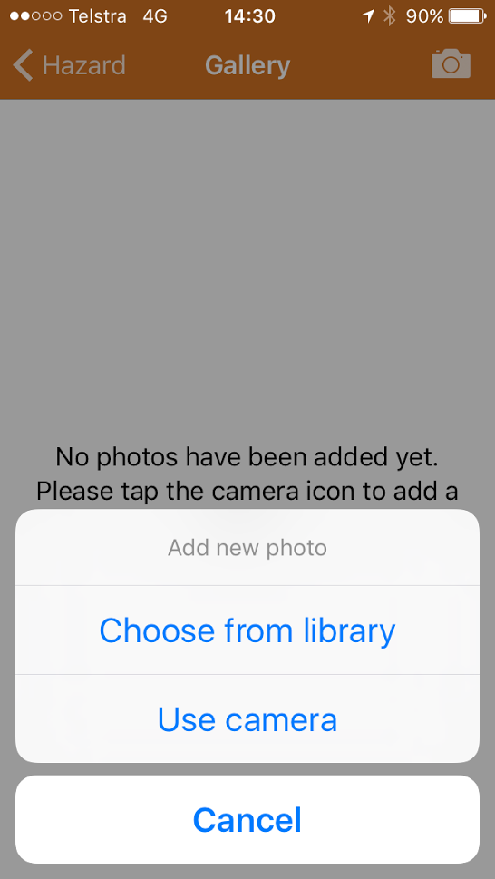
Add a Photo
Either choose an image from the library, or use take a photo

Slide 23
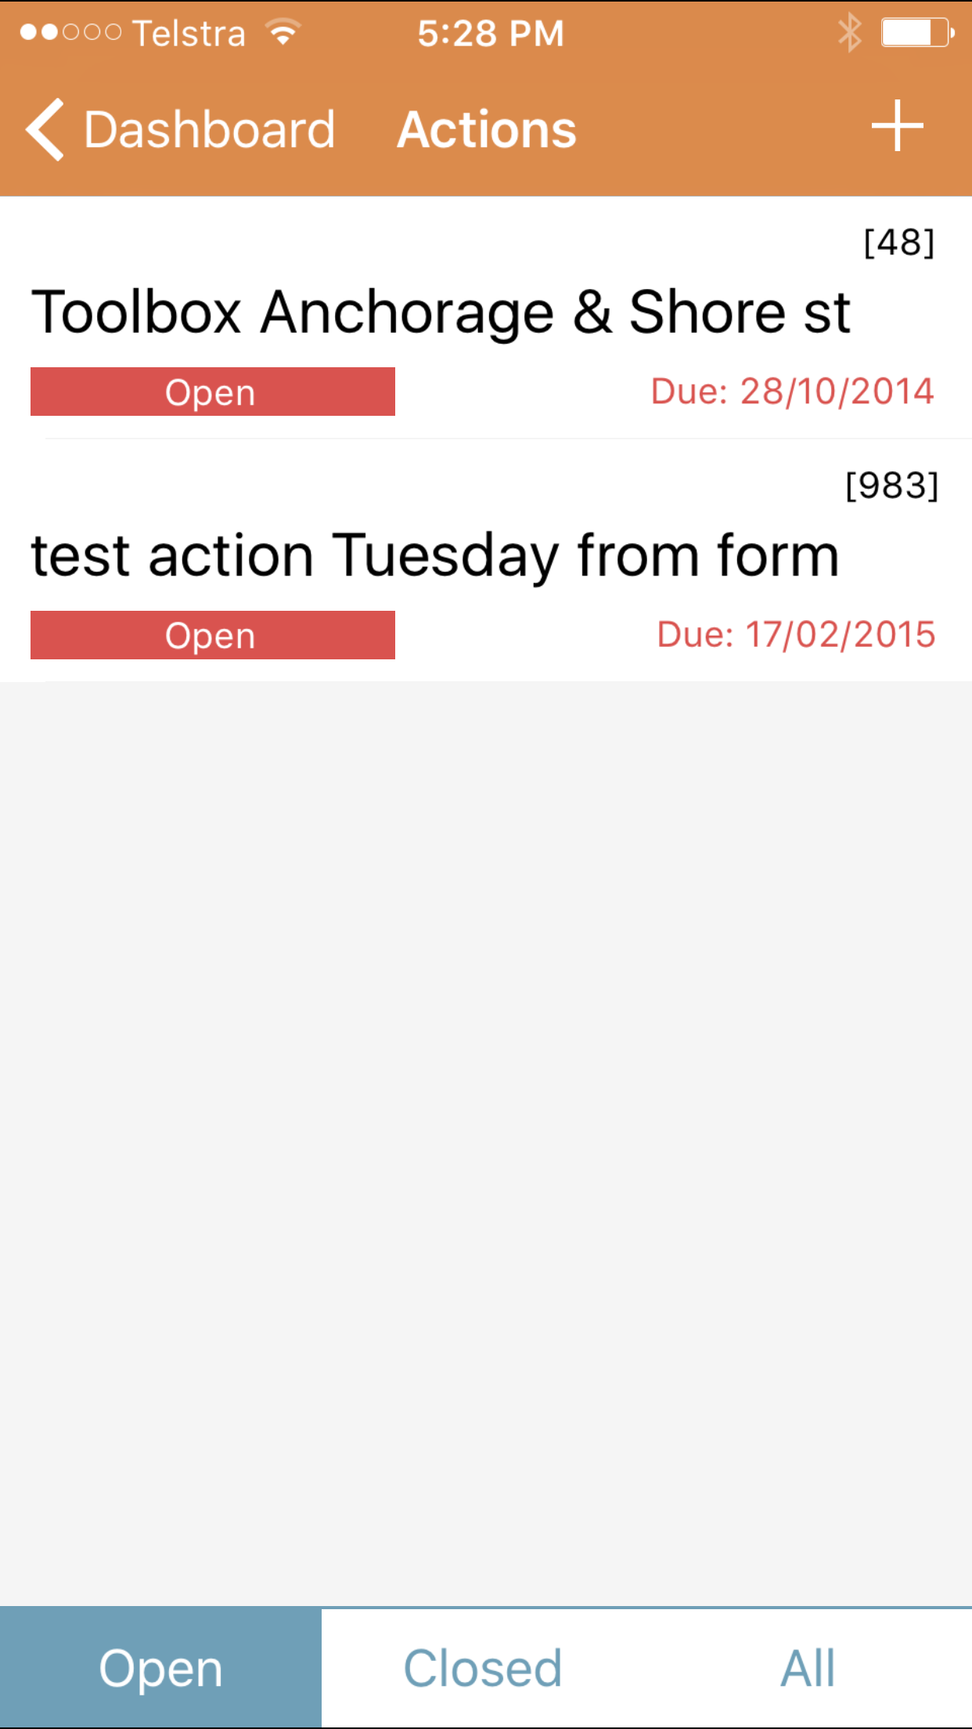
Actions – Inform Only
The Outstanding Actions link provides access to the actions for which the user is the Actionee.
Colour coding is included to indicate the status of the action.

Slide 24
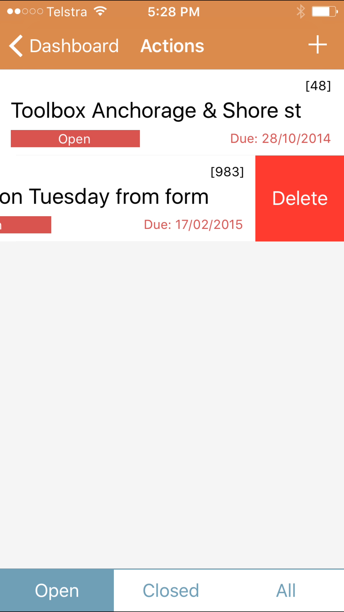
Actions – Inform Only
To delete an action, return to the actions list page and swipe to the left. Once the Delete button is visible, tap it to complete the deletion.
Deleted actions cannot be retrieved.
Actions which are Closed, or All Actions can be viewed by tapping the buttons at the bottom of the screen.

Slide 25
Menu
Menu

Slide 26
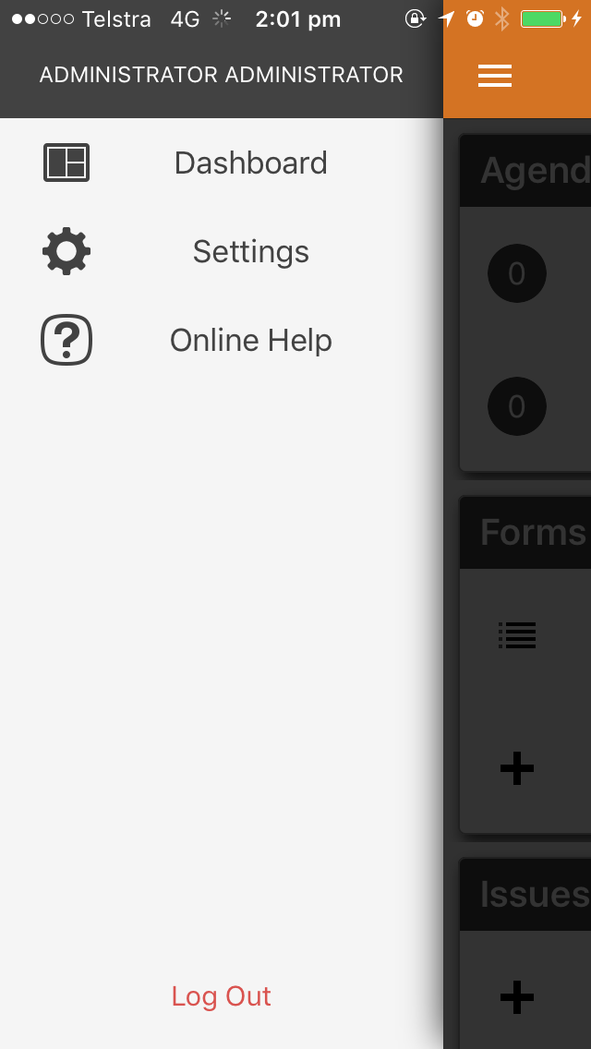
Menu
Tap the button at the top left to display the menu.
Settings
The settings menu item displays the current version of the Lucidity App that is on the device, and the site the device is logged in to.
Online Help
Tap to access online help

Slide 27
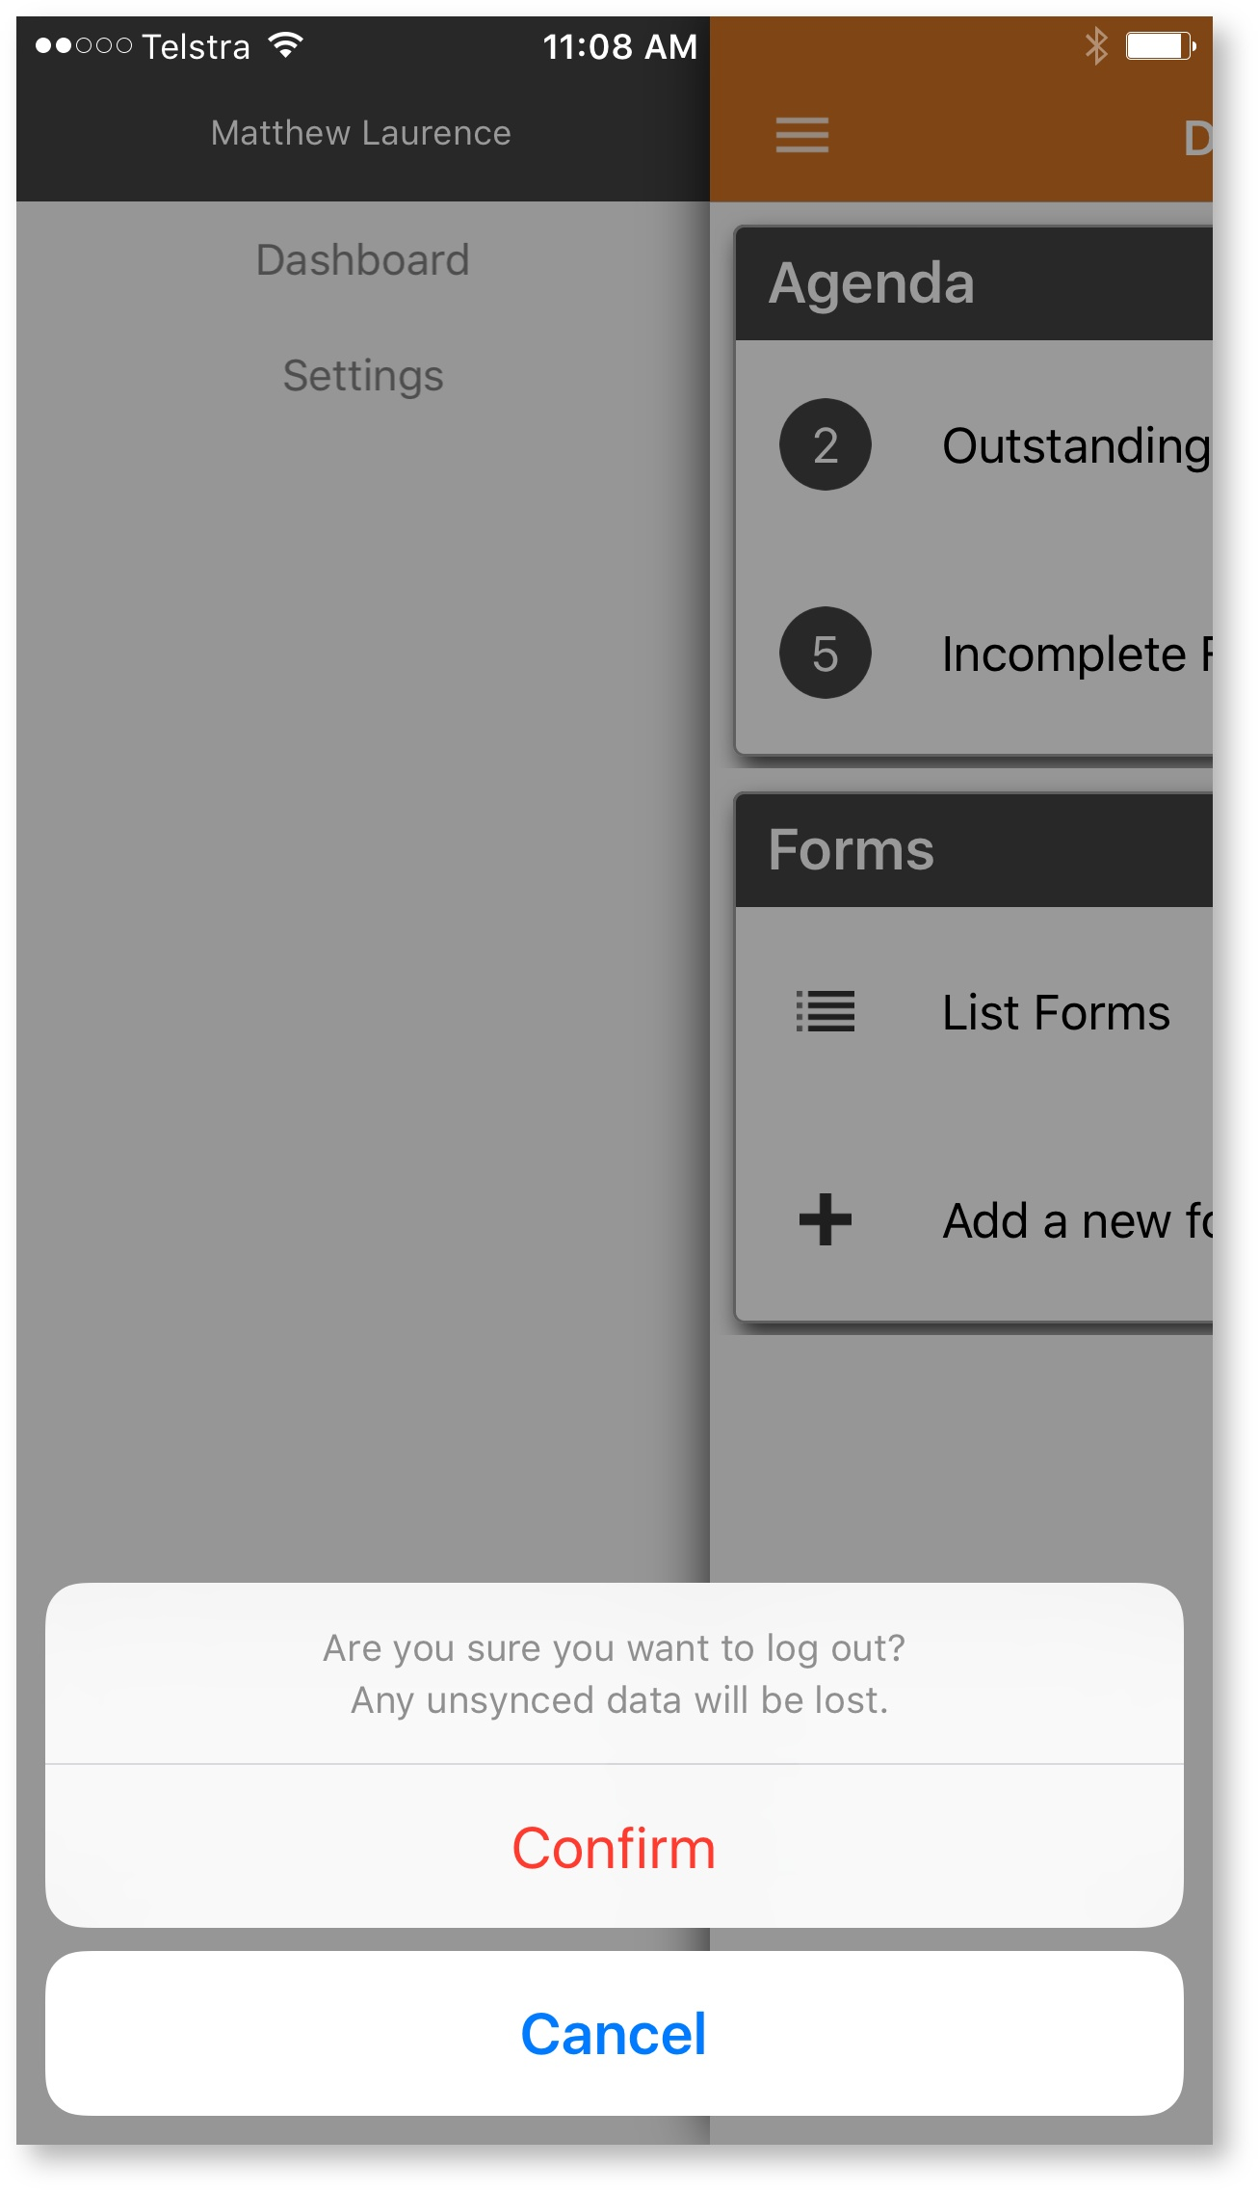
Menu
Logging Out
Tap the Log Out button at the bottom of the menu and then choose confirm. Any unsynchronised changes will be lost.

Slide 28
Offline Mode
The Lucidity App will store data for forms, hazards and incidents while the mobile device is out of range. When the device is back in range, it will sync newly created incidents / hazards, forms or edited forms with the database.

Slide 29
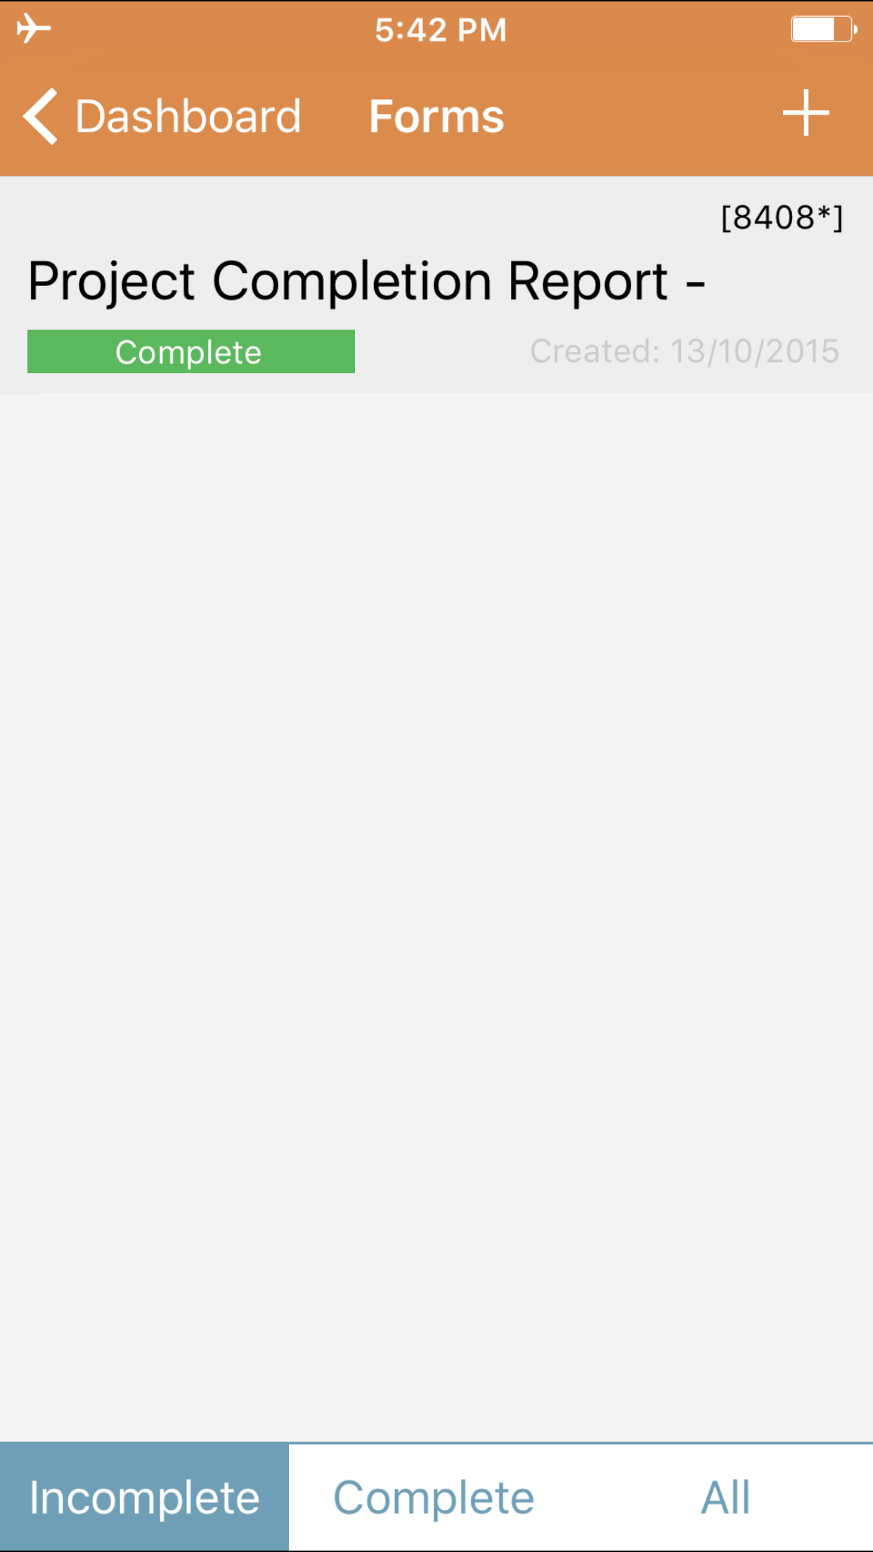
Offline Mode
From the list forms page it is possible to see which forms are waiting to be synced to the database. In this image, the device is in airplane mode (note the symbol in top right).
The Project Completion Report 8408 has been edited offline, and is waiting to sync. The * that is shown after the ID 8408 indicates to the user that this form is awaiting sync.
No action is required on the part of the user. When the mobile device re-establishes contact with the server, the form will be synced, and the * will disappear.

Slide 30
THANK YOU
You have completed this training package

